Slide 1

Dance With Ensemble
AI based Crop Recommendation System
Adhyansh Bhardwaj
Anant Jakhmola
Kartikay Sawhney
Ritik Aggarwal

Slide 2
SYSNOPSIS
India being an agricultural country, its economy predominantly depends on agriculture yield growth and agro-industry products.
58 % of the rural households depend on agriculture as their primary means of livelihood which acts as one of the largest contributors to the Gross Domestic Product (GDP).
We know that there is an decrease in crop production and shortage of food across the country which also has been consequence of bad crop selection and thus, leading to increasing farmer suicides.
We believe that there is an urgent requirement of a method which would help suggest the most suitable crop(s) which will maximize yield by summing up the analysis of all the affecting parameters.

Slide 3
Functionalities/ Features
CROP SUGGESTION- The main feature of the application is to suggest crops based on the input parameters.
The app will provide suggestions based on the parameters specified by the farmer like Soil type, previous crops, farm-size, source of irrigation.
Parameters like state, district, rainy days, temperature, humidity, season(kharif, rabi, winter etc.) are taken from location and date of the system automatically.
Other Informative Resources: KPK Centers, Agri Research Institutes.
With local language speech support.

Slide 4
Additional Features
Good Farming Practices: Organic Manure, Waste Management, personal hygiene etc.
Agricultural Schemes, contains information and direct in-app links to respective websites.
Feedback from the user asking whether the suggestions were helpful or not and the information gained from the user is put into the system to make better predictions for the future.
E-commerce (Beta-version)
User Manual (completed but not installed)

Slide 5
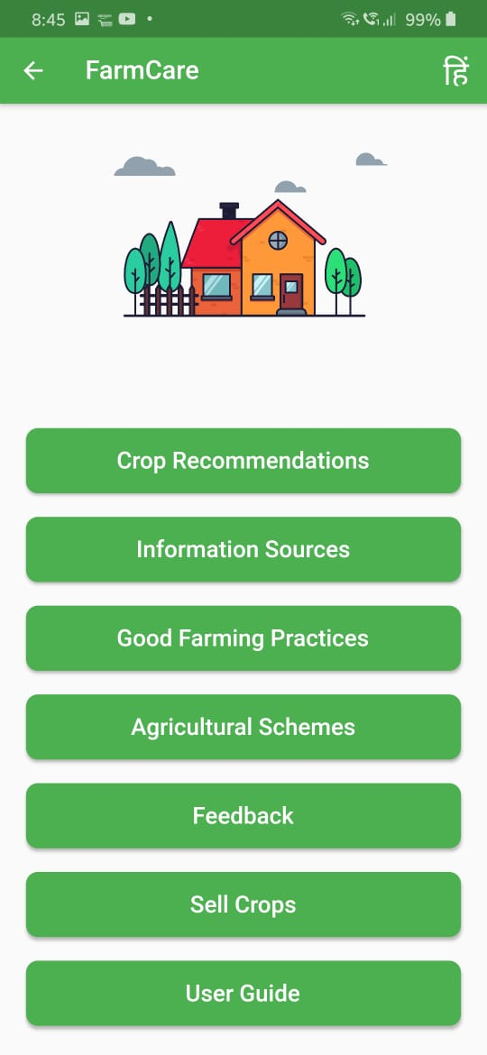
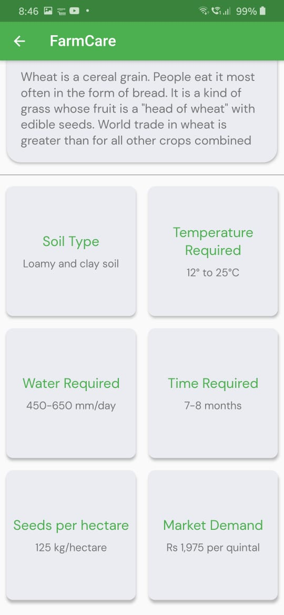
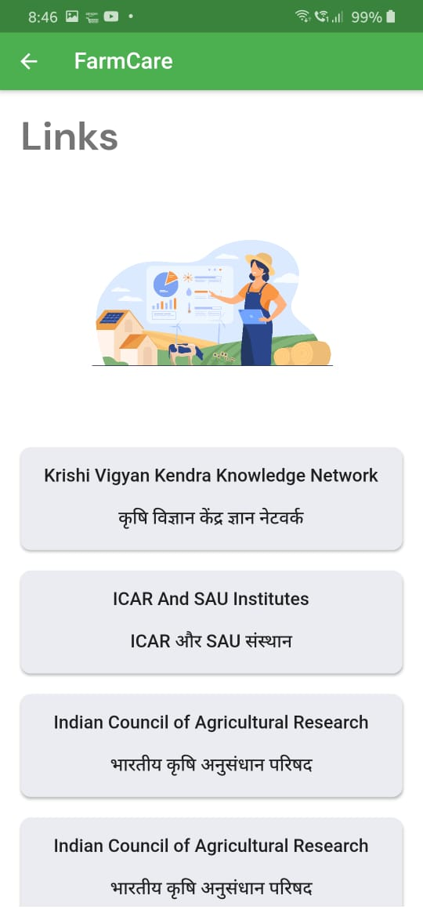
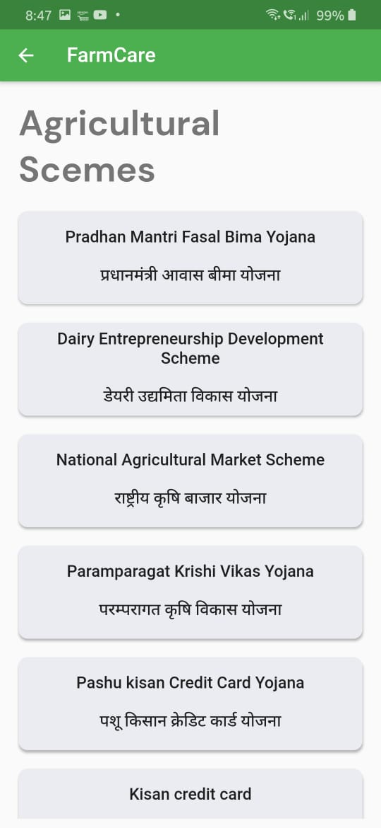
Screens

Slide 6
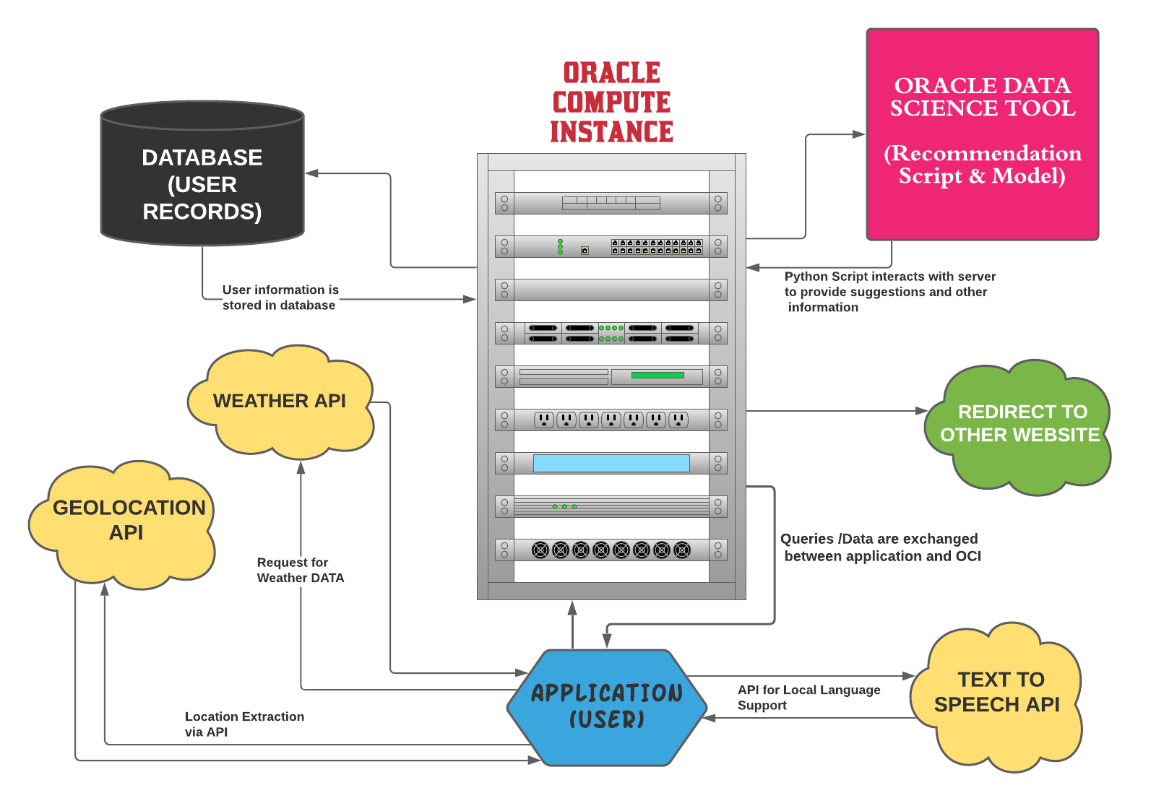
Architecture

Slide 7
Future Scope
1. Fully developed E-commerce store for farmers so that they can sell their crops at the price they wish (in accordance to MSP).
2. Text-to-Speech for local language support.
3. Including information from other helpful resources in order to make better recommendations.
4. Due to computational and other resource related limitations some good performing models were dropped from the final ensemble. Thus, in large computational environment the existing approach can give better results.

Slide 8
Demonstration . . . .

